Slide 1
TECHNICAL & DESIGN SPECIFICATION
Goy Clicker 3000 Documentation
Architecture, gameplay mechanics, exponential scaling formulas, and core JavaScript function API.

Slide 2



01. OVERVIEW
Game System Concept
Incremental Core Loop
Automated Progression
Endless Scale
Manual clicks convert into virtual currency ("Goys").
Purchased upgrades unlock exponential passive yield.
Infinite state progression with threshold achievements.

Slide 3
02. STEP 1 — STARTUP
Initial Game State Values
0 Score (Goys)
1 Per Click (SPC)
0 Per Second (SPS)
0 Live CPS Tracker

Slide 4

03. STEP 2 — INTERACTION
Gameplay Flow & Dynamic Visuals
1
Interactive Click Target
Main button fires click timestamps and adds base currency.
2
CSS Keyframe Animations
360° star rotation on active press with floating text pops.
Feedback Pop System
3
Rolling Window CPS
Triggers hardware reflow to re-apply text pops on rapid clicks.
Tracks timestamps within 1000ms window for real-time speed.

Slide 5
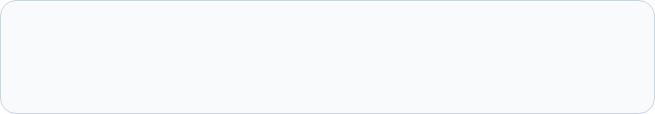
04. STEP 3 — PROGRESSION MATH
Exponential Cost Growth Model
Each purchase scales item cost exponentially based on owned quantity, preventing early saturation and balancing progression speed.

Slide 6
05. ECONOMY
Upgrade Catalog Specifications
Upgrade Name | Type | Yield Rate | Base Cost | Multiplier
Auto Clicker | Passive (SPS) | +1 Goy / sec | 15 | 1.35x
Double Tap | Manual (SPC) | +1 Goy / click | 50 | 1.45x
Super Generator | Passive (SPS) | +10 Goys / sec | 200 | 1.60x

Slide 7

06. ARCHITECTURE
Technology Stack
HTML5 Markup
CSS3 Styling
ES6 JavaScript
Semantic sectioning with accessibility live regions.
Glassmorphic backdrop filters and keyframe animations.
State management, event listeners, and timers.

Slide 8
07. API REFERENCE
Core JavaScript Function API
formatNumber(value): Formats raw floats into floored localized string outputs.
updateCps(): Cleans timestamp array past 1000ms to calculate clicks per second.
showClickFeedback(msg): Resets CSS animation classes to trigger visual pops.
getUpgradeCost(id): Computes exponential price curve based on current level.
updateUi() & buyUpgrade(id): Syncs DOM buttons, state, and affordability status.

Slide 9
Documentation Summary Complete
Goy Clicker 3000 specification review. Open for questions and architectural discussion.
Status: Verified & Operational

